Slide 1
Owning the Smart Home -
Logitech Harmony Hub
Joseph Bingham
03/03/2019

Slide 2


Who
Joseph Bingham
Tenable Inc, Zero Day Research
@pneumagennao

Slide 3


What we will talk about
Background
Vulns
What
Millions of end points around the world
XMPP auth bypass/creds
OS Command Injection
Application Command Injection
How much fun can we have?

Slide 4


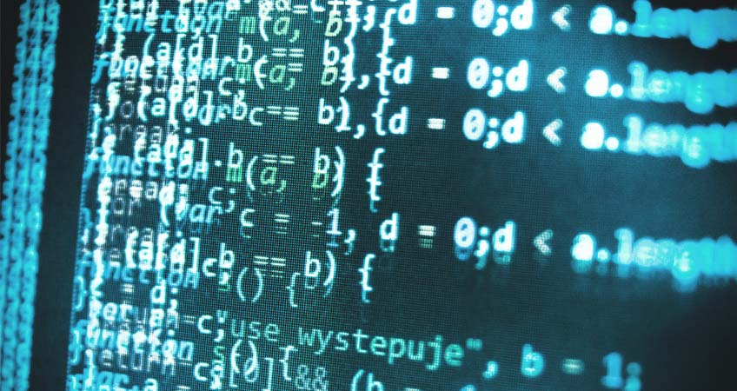
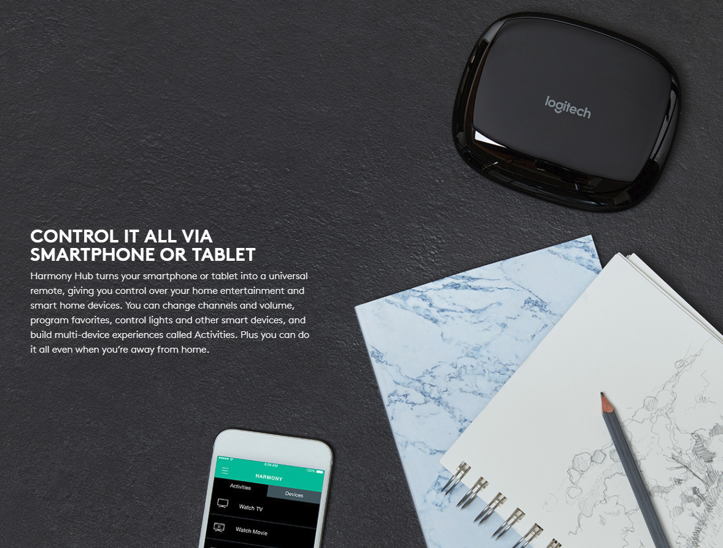
Imagined
Fully Automated House
Scripting capability

Slide 5
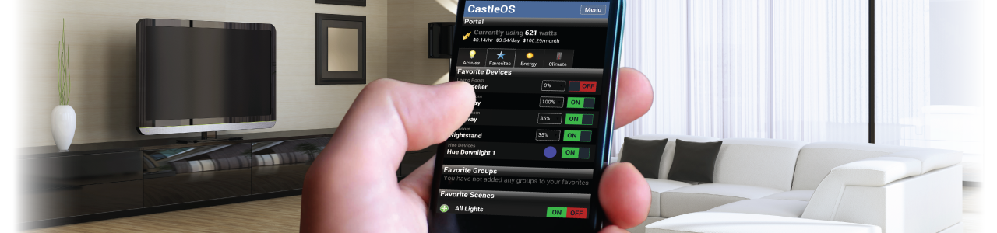
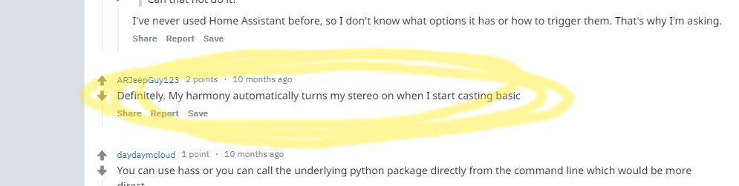
Background
Scripting backend
Hackable device
Infinite possibilities

Slide 6
Reversing
Vulns

Slide 7
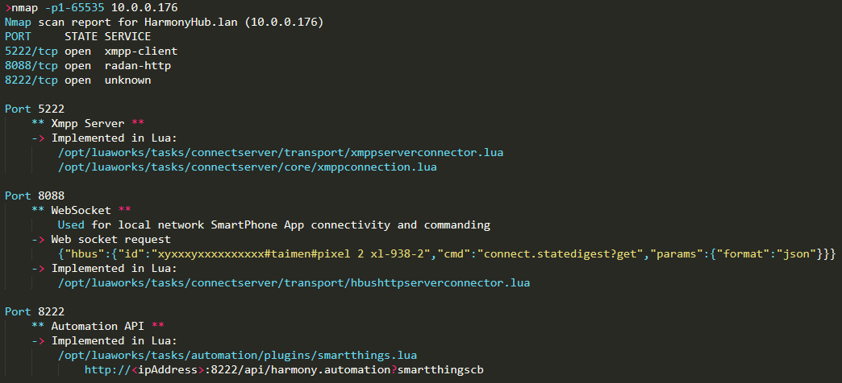
Device Network Footprint | Services
3 open services
Xmpp
Websocket
Unknown
Implemented in Lua
(firmware)

Slide 8
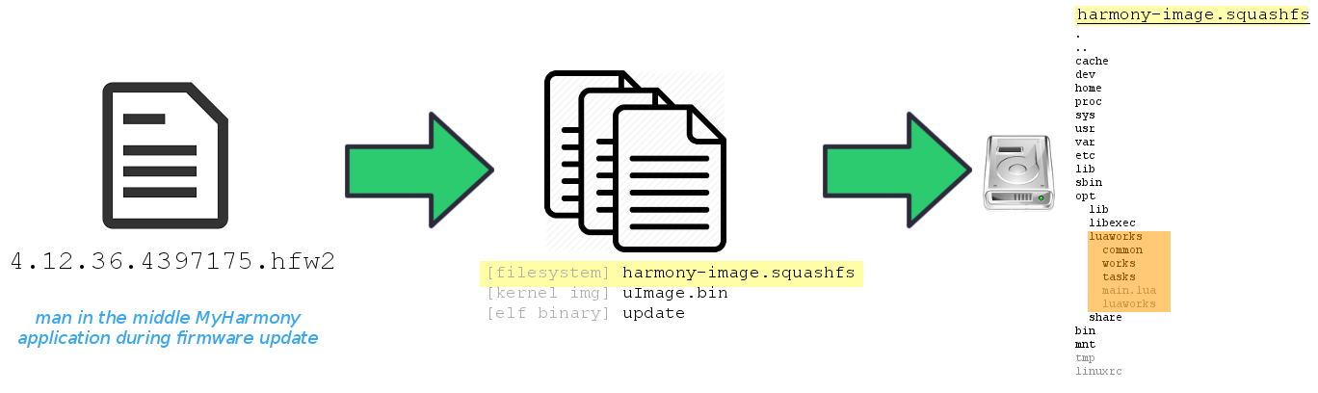
Device Firmware
Firmware - MyHarmony app
Lua 5.1 application code
using OpenWRT patches (important for decompilation)

Slide 9
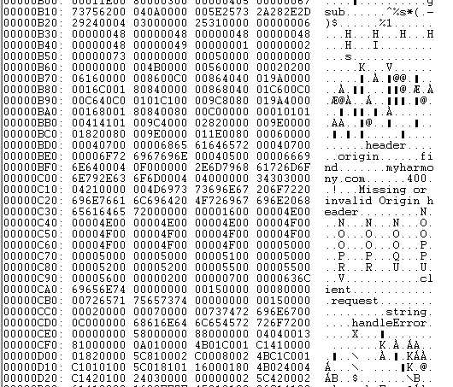
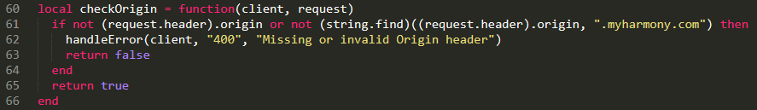

Device Application Code
OpenWRT Lua interpreter patches
https://github.com/openwrt/openwrt/tree/master/package/utils/lua/patches
Lua decompilation
https://github.com/viruscamp/luadec

Slide 10
Vulnerabilities Overview
CVE-2018-15720 XMPP Default Accounts
CVE-2018-15721 XMPP Authentication Bypass
CVE-2018-15722 Remote Server OS Command Injection
CVE-2018-15723 Application Command Injection

Slide 11
Vulnerabilities Overview
CVE-2018-15720 XMPP Default Accounts
CVE-2018-15721 XMPP Authentication Bypass
CVE-2018-15722 Remote Server OS Command Injection
CVE-2018-15723 Application Command Injection

Slide 12
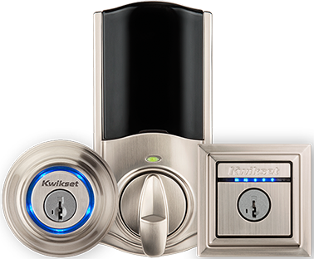
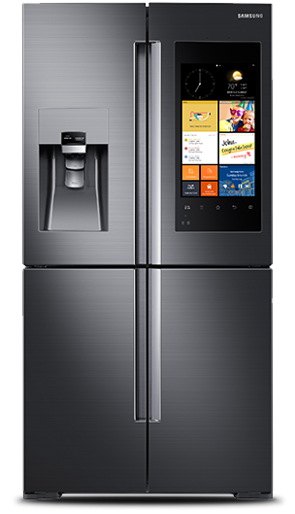

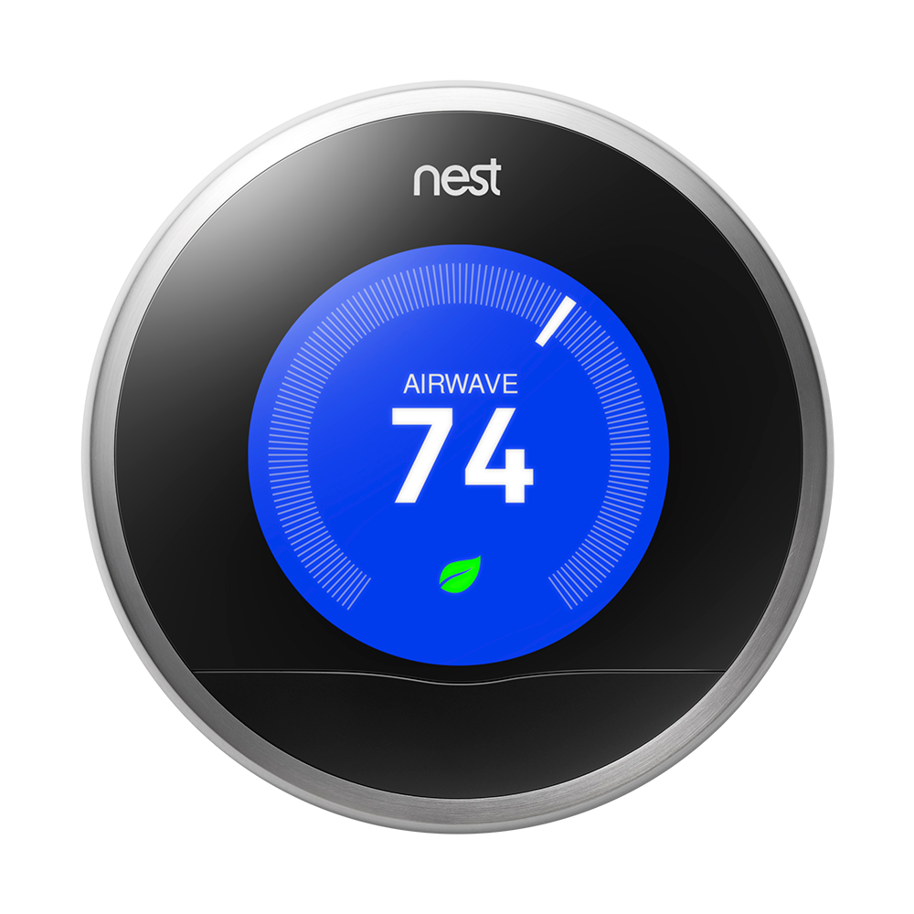
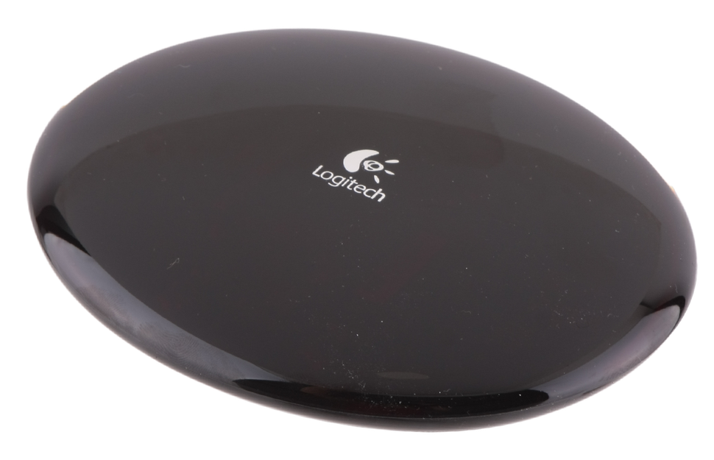
Vulns remote server os command injection
Harmony Connectivity
Logitech time server
Logitech discovery server
Logitech package server
Logitech synchronization server
Logitech authentication server
Logitech servers
User application
Devices

Slide 13
Vulns remote server os command injection
Harmony Connectivity
Logitech time server
Logitech discovery server
Logitech package server
Logitech synchronization server
Logitech authentication server
Logitech servers
User application
Devices

Slide 14
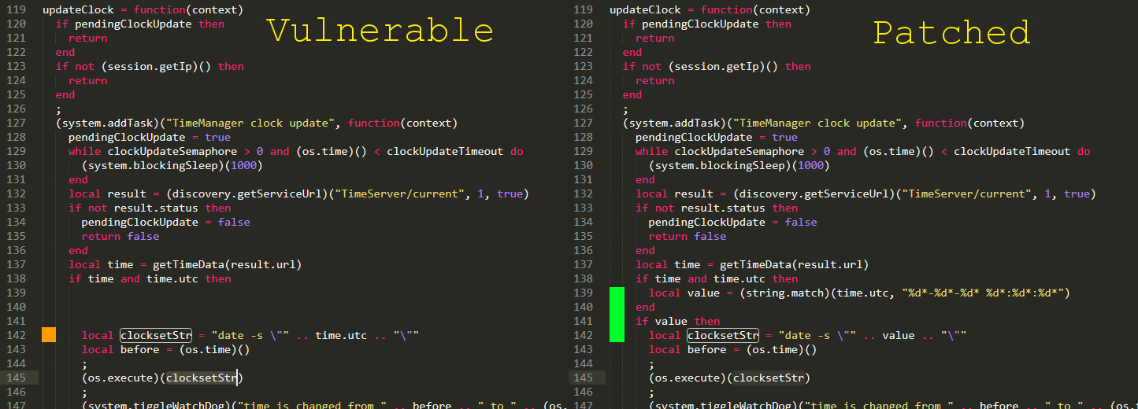
Vulns remote server os command injection
Patch Diff

Slide 15
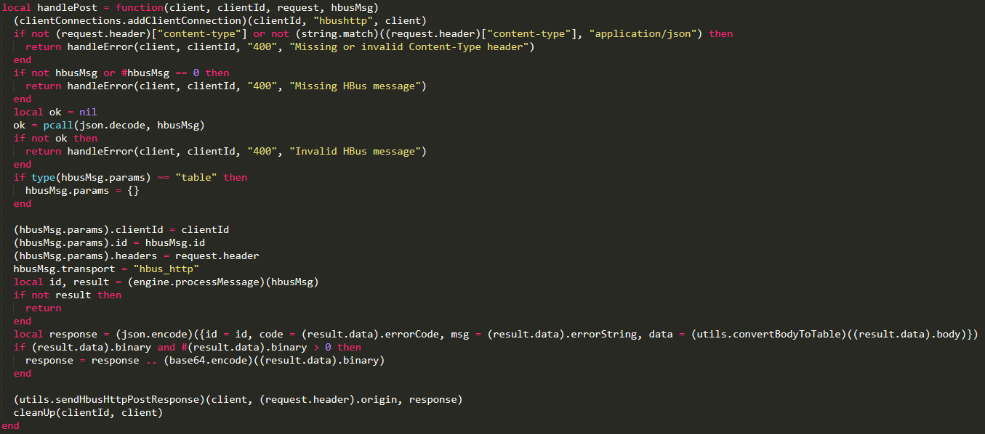
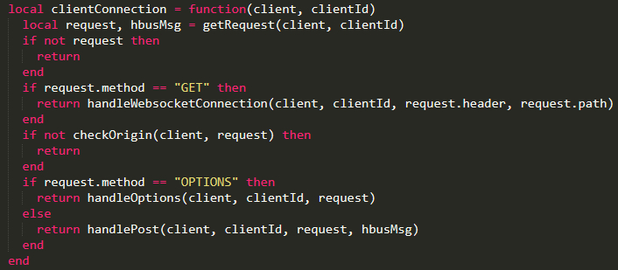
Vulns application command execution
Vulnerability

Slide 16
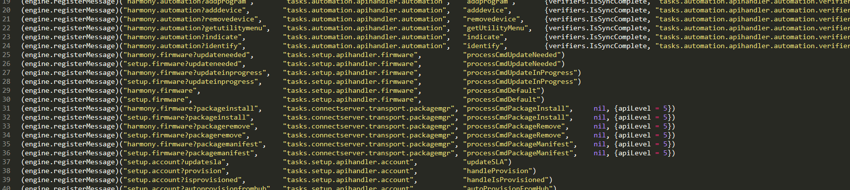

Vulns application command execution
Exploit

Slide 17
What

Slide 18
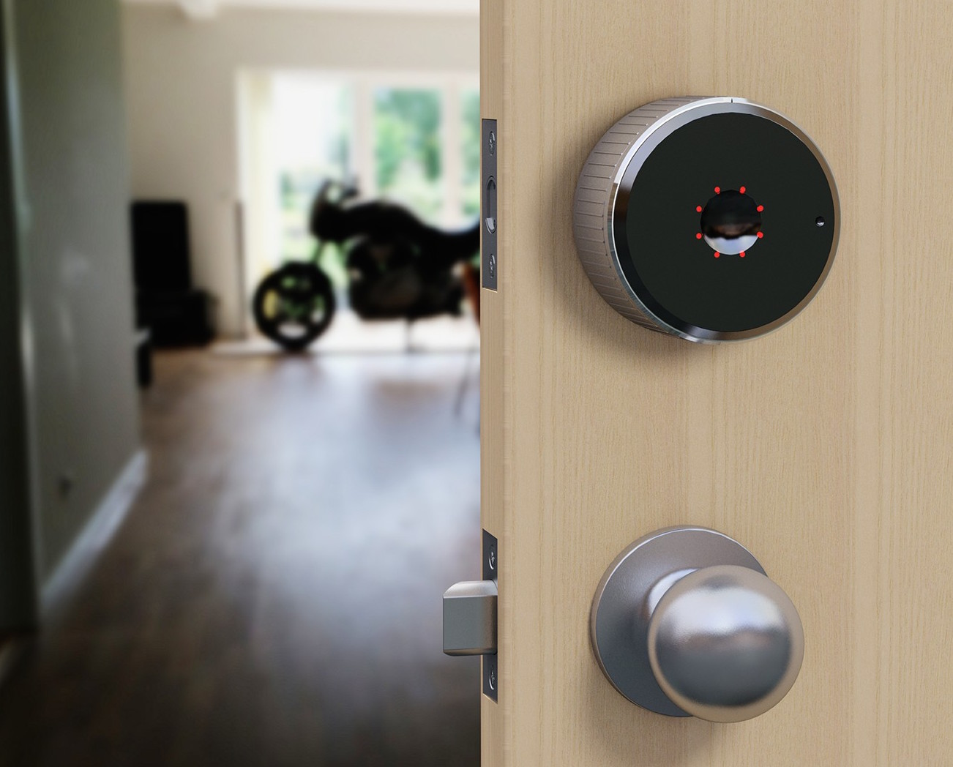
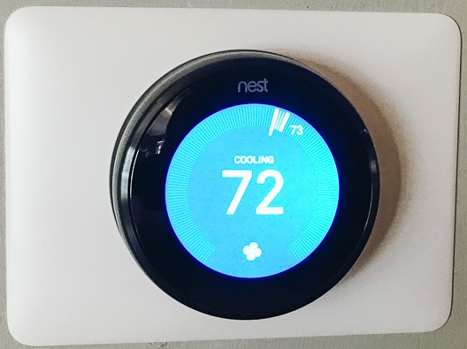
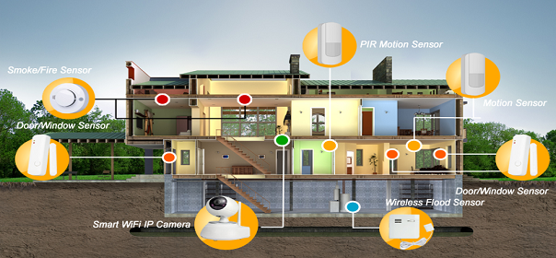
What controlling your home
Smart Locks
Security Sensors
Thermostat
Smart Appliances

Slide 19
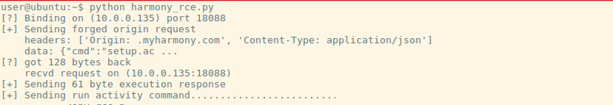
What controlling your home - DEMO
Unlocking a deadbolt

Slide 20
Questions
Tenable Inc, Zero Day Research
https://www.tenable.com/security/research
Full writeup:
https://medium.com/tenable-techblog/owning-the-smart-home-with-logitech-harmony-hub-fe2135e4adac

